Slide 1
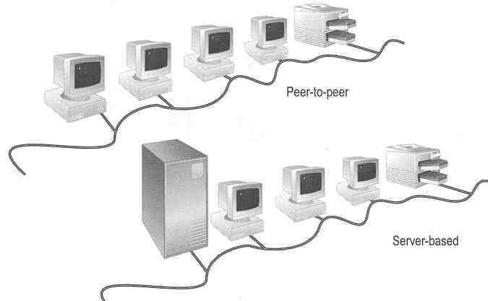
Introduction to Networking

Slide 2
References
Held G., “Internetworking LANs and WANs – Concepts, Techniques and Methods”, Wiley, 2nd Ed., 1998
  Comment: Good at concepts
Stallings W., “Data and Computer Communications”, Prentice Hall, 7th Ed., 2004
  Comment: Good at concepts and very up-to-date
Forouzan B. A, “Data Communications and Networking”, McGraw-Hill, 2nd Ed., 2000
  Comment: Many good revision questions at ends of chapters
Redmond W., “MCSE Training Kit: Networking Essentials Plus”, Microsoft Press, 2000
  Comment: Practical oriented

Slide 3
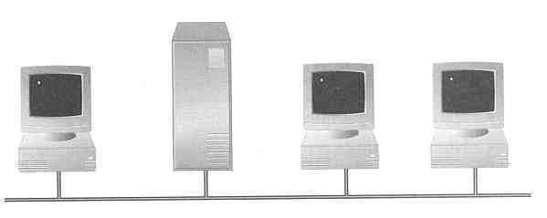

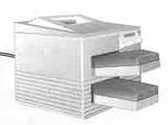
What is a Network?
A network consists of 2 or more computers connected together, and they can communicate and share resources (e.g. information)

Slide 4
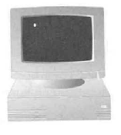
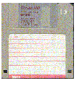
Why Networking?
Sharing information — i.e. data communication
Do you prefer these?
Or this?

Slide 5
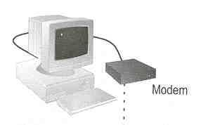
Sharing hardware or software
E.g. print document
Centralize administration and support
E.g. Internet-based, so everyone can access the same administrative or support application from their PCs

Slide 6
RISKS OF NETWORK COMPUTING
The security of a computer network is challenged everyday by:
  Equipment faults
  System failures
    Note: equipment faults and system failures may be caused by natural disasters such as floods, storms, or fires, and electrical disturbances
  Computer hackers
  Virus attacks

Slide 7
Terminology
Bandwidth -is a measurement of bit-rate of available (for network, data etc.) or for data transfer rate, the amount of data that can be carried from one point to another in a given time period (usually a second).
Packet- a packet is a segment of data sent from one computer or device to another over a network. A packet contains the source, destination, size, type, data, and other useful information that helps packet get to its destination and read.

Slide 8
IP Address- An Internet Protocol address (IP address) is a numerical label assigned to each device (e.g., computer, printer) participating in a computer network that uses the Internet Protocolfor communication.
Example: 191.255.255.255

Slide 9
NETWORKING HARDWARE AND SOFTWARE
Hub – electronic device (with a number of ports) used in a LAN to link groups of computers
Repeaters (also called amplifiers) – electronic devices that receive signals and amplify and send them along the network
Routers - electronic devices used to ensure messages are sent to their intended destinations
Gateway – consists of hardware and/or software that allows communications between dissimilar networks
Bridge – consists of hardware and/or software
that allows communication between two
similar networks

Slide 10
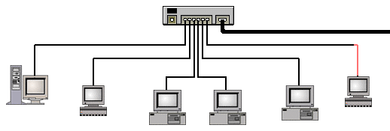
HUBS
A hub is usually a small rectangular box, often made of plastic, which receives its power from an ordinary wall outlet
A hub joins multiple computers (or other network devices) together to form a single network segment
On this network segment, all computers can communicate directly with each other
Small hubs can network four computers together
They contain four or sometimes five ports
Many times the fifth port is reserved for "uplink" which is the connecting of one hub to another hub or similar device (joining two segments together).
Larger hubs contain eight, 12, 16, and even 24 ports

Slide 11
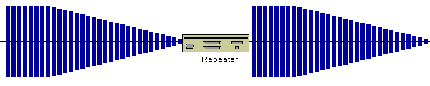
REPEATERS
A common problem in the networking world is that of weakening electrical signals. Electrical signals traveling through wires (such as copper wires used in most networks), weaken due to the wire's electrical resistance. This effect limits the lengths of the cable that can be used. A repeater will overcome this limit, when there is a need to connect two computers at a larger distance.
A repeater is connected to two cable segments. Any electrical signal reaching the repeater from one segment, will be amplified and retransmitted to the other segment.
An illustration of a repeater at work
The electrical signal entering the repeater at one end is weakened.
The repeater amplifies the electrical signals and resends the data.
Networks for Beginners: http://compnetworking.about.com/

Slide 12
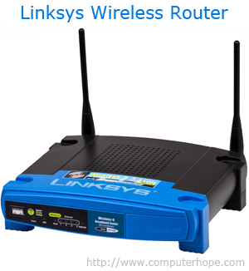
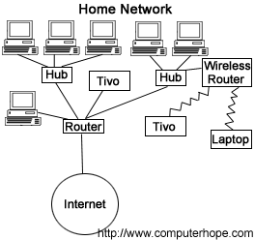
Router
A hardware device designed to take
incoming packets
analyse the packets
moving the packets to another network
converting the packets to another network interface,
dropping the packets,
directing packets to the appropriate locations,
and performing any other number of other actions.
The picture shows the Linksys BEFSR11 router and is what most home routers resemble.

Slide 13
Different types of routers
Brouter
Core router
Edge router
Virtual router
Wireless router

Slide 14
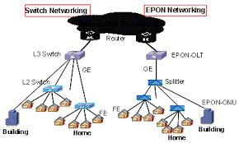
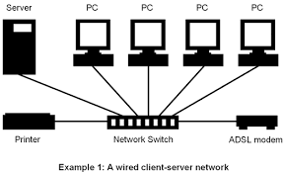
Switches or network switch
A network switch is a small hardware device that joins multiple computers together within one local area network (LAN). Ethernet switch devices were commonly used on home networks.

Slide 15

GATEWAY
Gateway is a router or a proxy server that routes between networks
"Gateway" is a term that was once used to refer to a routing device. Today, in the TCP/IP world, the term "router" is used to describe such a device.
The term gateway now refers to special-purpose devices, that perform protocol conversions. Gateways implement application layer conversions of information received from various protocols.
Examples of gateways found on today's markets are:
  VocalTec Gateway: A gateway that converts human speech traveling on analog phone lines into local area network protocol data, and visa-versa.
  RadVision Gateway: Converts video from digital phone lines into local area network protocol data, and visa-versa.

Slide 16
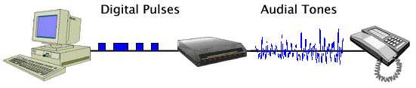
MODEMS
An illustration of data sent using a modem and a regular telephone line.
A modem is a device that converts digital data originating from a terminal or computer, to analog signals used by voice communication networks such as the telephone system. At one end, modems convert the digital pulses to audible tones and convert audio tones back to digital pulses at the other.
The word "Modem" stands for "MOdulator-DEModulator".
Networks for Beginners: http://compnetworking.about.com/

Slide 17
MODEMS
Transmission speed
Modems are available in different transmission speeds, which are measured in BPS (bits per second) also called BAUD rate.
Standard modems speeds: 9600 baud, 14400 baud, 28800 baud, 33600 baud, 56800 baud.
Internal/External
Internal modems are electronic cards. An internal modem is installed in one of the computer's expansion slot.
External modems are fully functioning external devices. The external modem is connected to a computer using a serial
cable to one of the computer's serial ports, and draws power from an external power source.
Networks for Beginners: http://compnetworking.about.com/

Slide 18
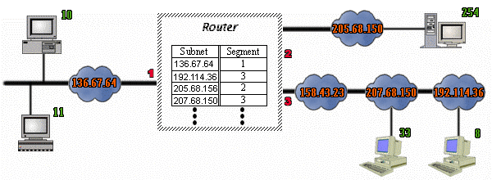
ROUTERS
Routers connect two or more networks and forward data packets between them. When data arrives from one of the segments, the router decides, according to it's routing table, to which segment to forward that data.
Networks for Beginners: http://compnetworking.about.com/

Slide 19
Routers are physical devices that join multiple wired or wireless networks together
Technically, a wired or wireless router is a Layer 3 gateway, meaning that the wired/wireless router connects networks together
A Gateway is a device that acts like a security guard and only allows data in or out if it has the right network headers

Slide 20
How many kinds of Networks?
Depending on one’s perspective, we can classify networks in different ways
  Based on transmission media: Wired (UTP, coaxial cables, fiber-optic cables) and Wireless
  Based on network size: LAN and WAN (and MAN)
  Based on topology (connectivity): Bus, Star, Ring
  Based on management method: Peer-to-peer and Client/Server
  …
  :
  :

Slide 21
Transmission Media
Two main categories:
  Guided (wired)― wires, cables
  Unguided (Wireless) ― wireless transmission, e.g. radio, microwave, infrared, sound, sonar

Slide 22
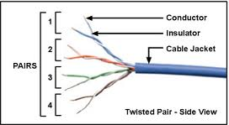
Wire-Based Media
Twisted –Pair Cable
Twisted pair consists of two conductors (normally copper), each with its own plastic insulation, twisted together.
Twisted-pair cable comes in two forms: unshielded and shielded
The twisting helps to reduce the interference (noise).
Supports transmission speed up to 1Gbps (bits / sec)

Slide 23
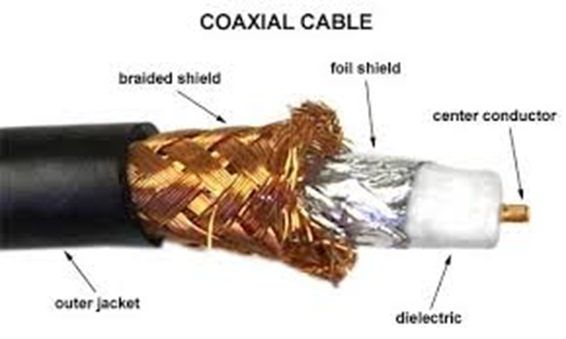
Coaxial Cable
Coaxial cable has two conductors.
One is a single wire in the centre of the cable, and the other is a wire mesh shield that surrounds the first wire, with an insulator between.
Supports transmission up to 10 Mbps.
More expensive

Slide 24

Fiber-Optic Cable
Fiber – Optic cable is made of glass or plastic and transmits signals in the form of light.
It can carry data at more than a billion of bits per second(100 Gbps).

Slide 25
Wireless Media
Wireless networks use radio, microwave or infrared signals that travel through the air (called ether) or water for transmitting data.

Slide 26
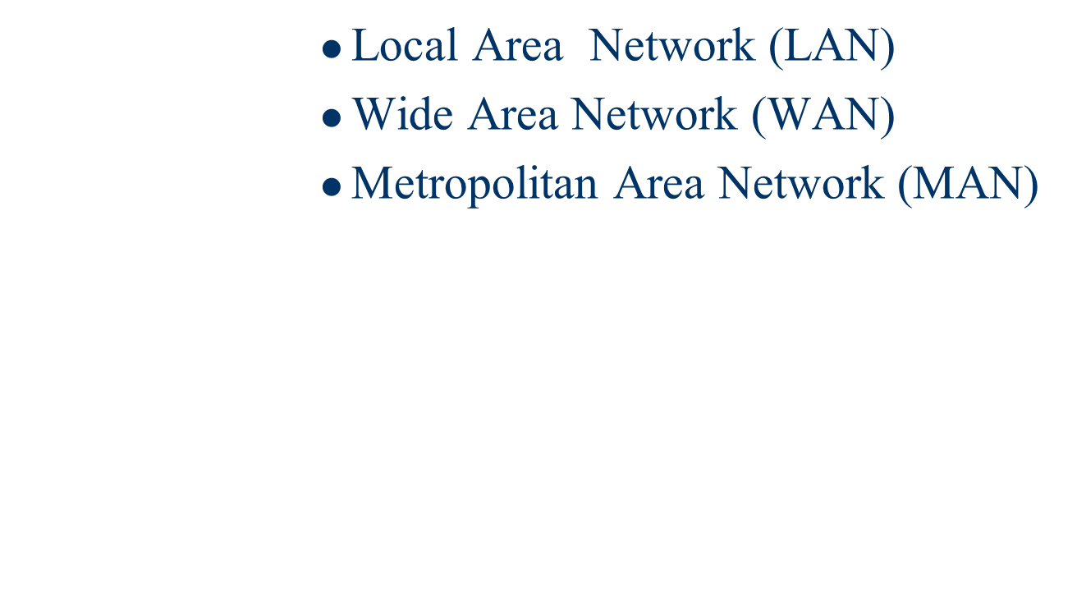
Types of Networks

Slide 27
LAN
A local area network (LAN) is a computer network that connects computers and devices in a limited geographical area (less than a few KM) .
Two computers linked together at home are the simplest form of a LAN.
LAN is mainly private.
Small network, short distance
A room, a floor, a building
Limited by no. of computers and distance covered
Serve a department within an organization
  Examples:
    Network inside the Student Computer Room
    Network inside your home

Slide 28
MAN
A Metropolitan Area Network is a network that interconnects computers in a geographic area (metropolitan area or campus) larger than that covered by even a large LAN but smaller than the area covered by a wide area network (WAN).
MANs are usually connected with fiber-optic cable, microwave transceivers or leased data landlines.
MANs ownership usually by more than a single organization.
Example :Several branches of a chain store within a city might find a MAN useful.

Slide 29
WAN
A wide area network (WAN) is a computer network that covers a broad area.
A WAN can be used to connects cities, states, regional, or national boundaries .
It is often formed by the joining together of LANs using routers in distant places.
WAN can be private or public.
WANs are usually connected using the Internet, ISDN landlines or satellite.
Example :The network connecting the ATM of a bank located in various cities or countries, Internet.

Slide 30
Wide Area Network (WAN)
  A network that uses long-range telecommunication links to connect 2 or more LANs/computers housed in different places far apart.
    Towns, states, countries
  Examples:
    Network of our Campus
    Internet
Your home
WAN
USA
Student Computer Centre

Slide 31
Difference between type of networks
Criteria | LAN | MAN | WAN
Cost | Low | High | Higher
Network size | Small | Large | largest
Speed | Fastest | Faster | Fast
Transmission media type | Twisted-Pair | Twisted-Pair and Fibre-Optic | Fibre-Optic, radio wave and satellite
Number of Computers | Smallest | Large | largest

Slide 32
Example WAN technologies:
  ISDN – Integrated Service Digital Network
    Basic rate: 192 Kbps Primary rate: 1.544Mbps
  T-Carriers ― basically digital phone lines
  Frame relay
    Each link offers 1.544Mbps or even higher
  ATM – Asynchronous Transfer Mode
    Support B-ISDN: 155Mbps or 622Mbps or higher
  SONET – Synchronous Optical Network
    Basic rate 51.84Mbps
    Support (9953.28Mbps) or even higher in the future

Slide 33
Example of WAN: Broadband Cable Network
Cable TV services have been extensively developed in most modern cities
Cable TV companies try to make use of their coaxial cable installed (that are supposed to carry TV signals) to deliver broadband data services
Many cable network wiring has been replaced with hybrid fiber-coax (HFC) ― i.e. use of fiber-optic cable to connect to the subscribers’ buildings, and then the original coaxial cable to connect to each household

Slide 34

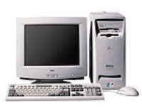
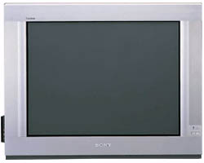
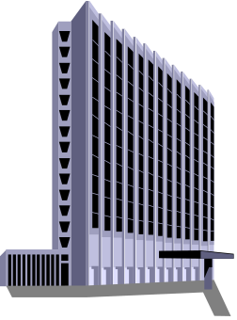
The connection is shared by a number of subscribers, hence may raise performance and security problems
PC
TV
Fiber-optic cable
Cable Drop
Coaxial
Cable
Cable company

Slide 35
HOW ARE NETWORKS CATEGORIZED?
Networks are usually classified using three properties:
    Topology
    Protocol
    Architecture

Slide 36
NETWORK TOPOLOGIES
Network Topology (or layout) – refers to the way computers and peripherals are configured to form networks
  Bus topology – all computers are linked by a single line of cable
  Star topology – multiple computers and peripheral devices are linked to a central computer, called a host
  Ring topology – each computer or workstation is connected to two other computers, with the entire network forming a circle
  Hybrid topology – combine network layout
  types to meet their needs

Slide 37
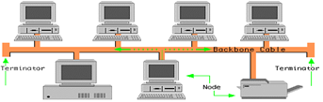
Bus topology
This type of network was widely used in the 1980’s
Commonly referred to as a linear bus.
All the devices on a bus topology are connected by one single cable.
A linear bus topology consists of a main run of cable with terminals.
In this configuration every computer (node) shares the networks total bus capacities.
In this configuration adding more computers will reduce the access speed on the network.
Each computer communicates to other computers on the network independently.

Slide 38
Merits and Demerits
Merits
Bus topologies are relatively easy to install
Requires less cabling.
Best suited for small networks.
Demerits
Many devices connect to a single cable "backbone". If the backbone is broken, the entire segment fails.
The cable length is limited. This limits the number of stations that can be connected.
Terminators are required at both ends of the backbone cable.
Difficult to identify the problem if the entire network shuts down

Slide 39
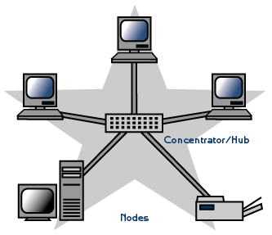
Star topology
A star network has a central connection point - like a hub or switch.
All nodes are connected to a central hub.
In a Star topology every node is connected through a central device such as a Hub, Switch or Router
Compared to a Ring or Bus topology a Star topology requires that more thought be put into its setup
All traffic emanates from the hub of the star. The central site is in control of all the nodes attached to it.
The central hub is usually a fast, self contained computer and is responsible for routing all traffic to other nodes.

Slide 40
Merits and Demerits
Merits
Easy to install and wire.
No disturbances to the network when connecting or removing devices.
Easy to detect faults and to remove parts.
Demerits
The network operation depends on the functioning of the central hub. Hence, the failure of the central hub leads to the failure of the entire network.
Requires more cable.
More expensive than bus topologies because of the cost of the hubs, etc.

Slide 41
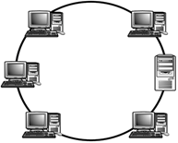
Ring Topology
In a ring network, every device has exactly two neighbors for communication purposes.
All messages travel through a ring in the same direction.
Nodes are connected in a circular chain, with the channel beginning and ending at the same computer.
The entire network forms a circle
Data only travels in one direction on a Ring network

Slide 42
Merits and Demerits
Merits
Less cable required
The data being transmitted between two nodes passes through all the intermediate nodes. A central server is not required for the management of this topology.
Demerits
The movement or changes made to network nodes affects the performance of the entire network.
Messages propagate in one direction only.
The network fails if a single node fails.

Slide 43
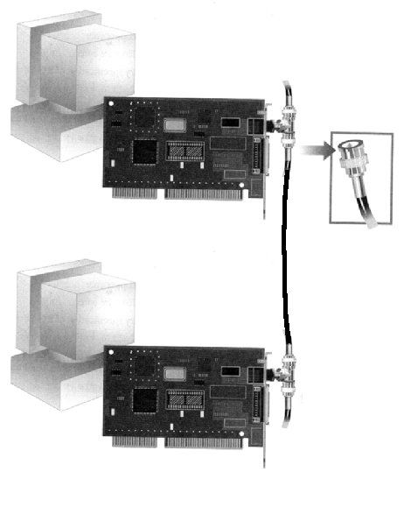
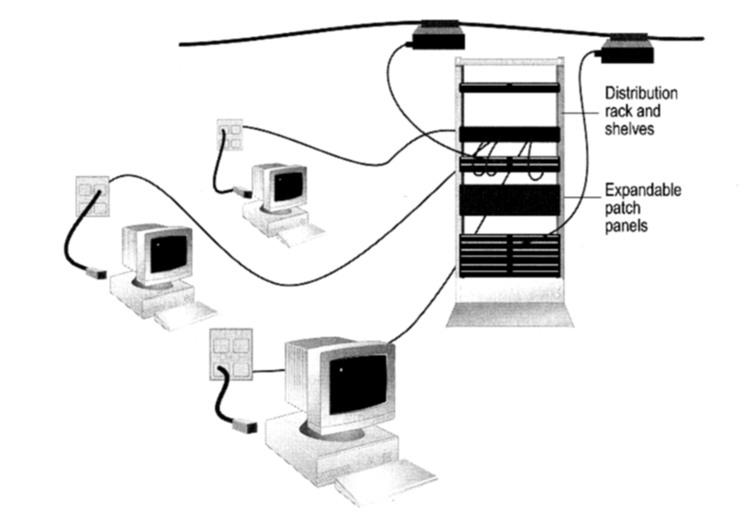
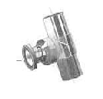
How to construct a network with Bus / Star Topology?
  Bus Topology
Coaxial cable
  Star Topology
BNC T-Connector
Network Card

Slide 44
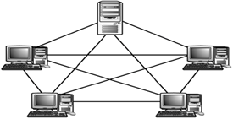
Mesh Topology
The mesh topology connects all devices (nodes) to each other.
Each node has a separate connection to every other node.
Also called as Complete network.

Slide 45
Merits and Demerits
Merits
The arrangement of the network nodes is such that it is possible to transmit data from one node to many other nodes at the same time.
if any cable fails, there are many other ways for two nodes to communicate.
Demerits
Mesh topology uses lots of cables to connect every node with every other node.
It is very expensive to wire up.

Slide 46
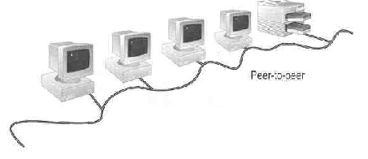
Peer-to-Peer Networks
Peer-to-peer network is also called workgroup
No hierarchy among computers ⇒ all are equal
No administrator responsible for the network
Peer-to-peer

Slide 47
Advantages of peer-to-peer networks:
  Low cost
  Simple to configure
  User has full accessibility of the computer
Disadvantages of peer-to-peer networks:
  May have duplication in resources
  Difficult to uphold security policy
  Difficult to handle uneven loading
Where peer-to-peer network is appropriate:
  10 or less users
  No specialized services required
  Security is not an issue
  Only limited growth in the foreseeable future

Slide 48
Clients and Servers
  Network Clients (Workstation)
    Computers that request network resources or services
  Network Servers
    Computers that manage and provide network resources and services to clients
      Usually have more processing power, memory and hard disk space than clients
      Run Network Operating System that can manage not only data, but also users, groups, security, and applications on the network
      Servers often have a more stringent requirement on its performance and reliability

Slide 49
Advantages of client/server networks
  Facilitate resource sharing – centrally administrate and control
  Facilitate system backup and improve fault tolerance
  Enhance security – only administrator can have access to Server
  Support more users – difficult to achieve with peer-to-peer networks
Disadvantages of client/server networks
  High cost for Servers
  Need expert to configure the network
  Introduce a single point of failure to the system

